Slide 1
Observation Status in Hospital eCQMs
eCQM Team

Slide 2
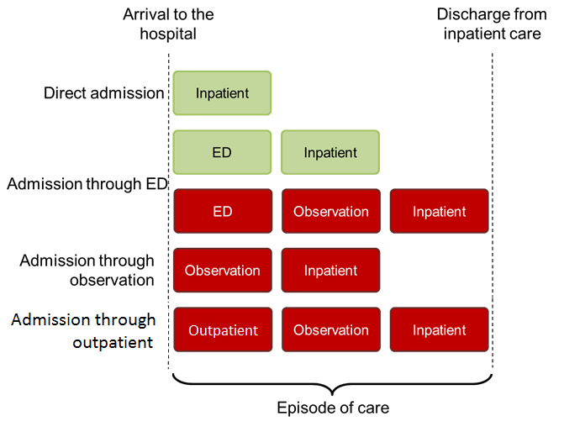
Implementation questions/issues
Logic does not account for observation status timeframe (CQM-1608)

Slide 3
Issue Overview
Care provided while a patient is in observation (prior to being admitted to inpatient care) may not be accounted for in the measure logic (CQM-1608)
Care provided while in emergency, or outpatient status may not be accounted for either
CQL has episode of care, doesn’t matter where they start, relates to an encounter
Vendors define episode of cares differently
Clinical intent and the Technical field have differing views on episode of care

Slide 4
Issue impact – CRP feedback
Issue is significant and perceived to affect measure calculation results
Issue impacts most EH eCQMs to varying degrees
Variability in how ED  observation  inpatient is managed within an EHR
Issue relates/overlaps with ED visit ends <= 1 hour of inpatient admission
Observation vs. inpatient as administrative artifact
Policy implications of observation status
Implementers agree it’s a difficult issue to solve

Slide 5
Possible interim “patches”
#1 Add guidance directing implementers to map observation to inpatient admission, when applicable
#2 Use a timing constraint only to cover both ED and observation implicitly (e.g. <= 3 day(s) SBS Inpatient Encounter)
#3 Model observation status explicitly in the logic (e.g. as encounter, location, ED disposition)

Slide 6
Patch # 2 - Using a timing constraint: effort vs. benefit
Can “pick up” on events prior to arrival
Can be confusing if applied only to some eCQMs (e.g. VTE, STK-5)
Cannot be applied to eCQMs dependent on arrival time (e.g. STK-5)
Does not resolve observation status issue when eCQM requires ED visit (e.g. ED-1)
May not meet measure requirements (e.g. STK-8, STK-10)

Slide 7
Long term optimal solution
Use CQL to define hospital arrival unambiguously:
Earliest of:
ED visit start
Observation start
Inpatient admission

Slide 8
Current Hospitalization Function
Hospitalization Function returns the total interval for admission to discharge for the given encounter, or for the admission of any immediately prior emergency department visit to the discharge of the given encounter.
(Encounter "Encounter, Performed" ): ( singleton from ( ["Encounter, Performed": "Emergency Department Visit"] EDVisit
where EDVisit.relevantPeriod ends 1 hour or less on or before start of Encounter.relevantPeriod) ) X
return if X is null then Encounter.relevantPeriod else Interval[start of X.relevantPeriod, end of Encounter.relevantPeriod]

Slide 9
Examples
STK 5
TJC."Ischemic Stroke Encounter" IschemicStrokeEncounter
with ["Medication, Administered": "Antithrombotic Therapy"] Antithrombotic
such that Antithrombotic.relevantPeriod starts 1 day or less on or after day of start of Global."Hospitalization"(IschemicStrokeEncounter)
TJC."Ischemic Stroke Encounter" IschemicStrokeEncounter
with "Thrombolytic Medication" Thrombolytic
such that Thrombolytic.relevantPeriod starts during Global."Hospitalization"(IschemicStrokeEncounter)
TJC."Ischemic Stroke Encounter" IschemicStrokeEncounter
with "Thrombolytic Therapy Medication or
Procedures“ ThrombolyticTherapy such that
ThrombolyticTherapy.relevantPeriod starts 24 hours
or less before start of
Global."Hospitalization"(IschemicStrokeEncounter)
Hospitalization Function
Global.Hospitalization (Encounter "Encounter, Performed")
( singleton from ( ["Encounter, Performed": "Emergency Department Visit"] EDVisit
where EDVisit.relevantPeriod ends 1 hour or less on or before start of Encounter.relevantPeriod
) ) X
return if X is null then Encounter.relevantPeriod else Interval[start of X.relevantPeriod, end of Encounter.relevantPeriod]

Slide 10
Proposed Hospitalization Function
Proposing to modify the current Hospitalization Function to work as below –
Look for ED Encounter => Null Or Not Null
=> Look for Observation Encounter => Null or Not Null
=> Look for Inpatient Encounter
This above logic would need to cover 3 scenarios
ED Encounter would need to be tied to the Observation Encounter which would be tied to the Inpatient Encounter
ED Encounter would need to be tied to Observation Encounter by less than or equal to 1 hr
ED Encounter would need to be tied to Inpatient Encounter by less than or equal to 1 hr
Observation Encounter would need to be tied to Inpatient Encounter by less than or equal to 1 hr

Slide 11
Observation SNOMED Codes
SNOMED codes are available to use for representing Observation within eCQMs.
Value set “Observation Services” -(2.16.840.1.113762.1.4.1111.143)
Includes 3 Observation SNOMED procedure codes that are of interest – See Below
Hospital admission, for observation (procedure) – 76464004
Hospital admission from observation unit (procedure) – 448851000124103 - Seems relevant and it is in the same parent hierarchy in SNOMED as “Hospital admission, for observation (procedure)”
Admission to observation unit (procedure) – 448951000124107 - Comes from the Parent code of “Admission to establishment (procedure)”
Needs more thought and debate

